Slide 1

Airline Delay Prediction Under Extreme Weather Conditions
APAN5400
Term Project Proposal
Team 1: Ana Zegarra,
Arshia Mahant, Poorva Desai, Samatha Krishna & Shirley Zhang

Slide 2
Background &
Definition of the Business Use Case
Introduction:
Flight delays and cancellations caused by severe weather cost U.S. airlines millions of dollars annually, disrupt schedules, and frustrate passengers. This project aims to develop a predictive analytics system that assesses the impact of extreme weather( storms, hurricanes, heavy rain, snow) on flight punctuality across major U.S. airports.
Problem Statement:
Airlines and airports struggle to anticipate cascading delays from weather events. By integrating flight and meteorological data, our ETL pipeline will enable more accurate forecasting and resource optimization.
Objectives:
Focused on Top 15 airports in the US, and analyzed 10 years worth of historical data.
Quantified the correlation between weather severity and flight delay probabilities.
Created a machine learning pipeline to predict delay likelihood under upcoming weather patterns.
Provided insights for scheduling, passenger alerts, and operational planning.
Business Value & Impact:
For Airlines: Predictive insights improve schedule resilience and fuel planning.
For Airports: Enable proactive runway and gate allocation.
For Passengers: Increased reliability and advanced delay notifications.
For Regulators: Data driven understanding of how climate trends affect aviation efficiency

Slide 3
Data Source Specification and Procurement
Data was procured through a hybrid sourcing strategy utilizing both direct public APIs and aggregated research repositories. While NOAA’s Climate Data Online and Hurricane Data APIs were accessed directly to supply granular hourly weather observations and historical storm tracks respectively, flight performance records were obtained via the Airline On-Time Statistics and Delay Causes dataset on Kaggle.
* * The actual size of the full data is much larger than the one we used now since we only fetched data for 15 airports from 2015 to 2025
NOAA Historical Weather Data
NOAA Hurricane Data
Airline Delay Data
Source:
NOAA Climate Data Online (CDO) API
Format:
JSON / CSV / API
Key Variables:
Flightmonth, Station ID, timestamp, temperature, precipitation, wind, visibility, weather code
Description:
Hourly weather observations for 15 mapped airport weather stations.
Data Size:
10 MB
Last Update:
Ongoing
Source:
NOAA Hurricane Data API
Format:
JSON / API
Key Variables:
Flightmonth, Storm ID, name, time, location, wind speed, pressure, category
Description:
Historical tracks and intensity of tropical storms and hurricanes affecting U.S. airspace.
Data Size:
55 MB
Last Update:
Seasonal
Source:
Airline On-Time Statistics and Delay Causes (Kaggle)
Format:
CSV/API
Key Variables:
Flightmonth, weather delay, carrier delay
Description:
This raw dataset was pulled from the Airline On-Time Statistics and Delay Causes dashboard on the BTS website for all carriers and all airports.
Data Size:
2 GB
Last Update:
Ongoing
Notes:
Prioritize FAA + NOAA Climate Data first, mark others future expansion
Will potentially look into OOpen WeatherMap API
openweathermap.org JSON
Real-time and forecasted weather conditions for active airports
Real-time

Slide 4







Extract Transform Load
Pipeline
API Connection
Created API connection for Airline delay dataset using Kaggle Hub
Created API endpoint for Hurricane dataset
Generated API connection for NOAA weather data set using NOAA token
Used Spark to parallelize tens of thousands of Weather API calls
MongoDB storage
Connected all three datasets to MongoDB for flexible schema storage
Weather data df : noaa_weather_raw
Hurricane data df: hurricane_ibtracs_na
Airline delay data df:
airline_delay_cause
MongoDB PostgreSQL
Cleaned and transformed three datasets
Created a standard monthly date for all datasets for later merging
Cleaned datasets are pushed to PostgreSQL, creating relational staging tables
PostgreSQL Tableau
Conducted SQL query to merge the three staged datasets into one fact table using left join
Connected PostgreSQL to Tableau for dashboard and visualization
Tableau Flask
Embedded the Tableau Dashboards on a Flask interface

Slide 5
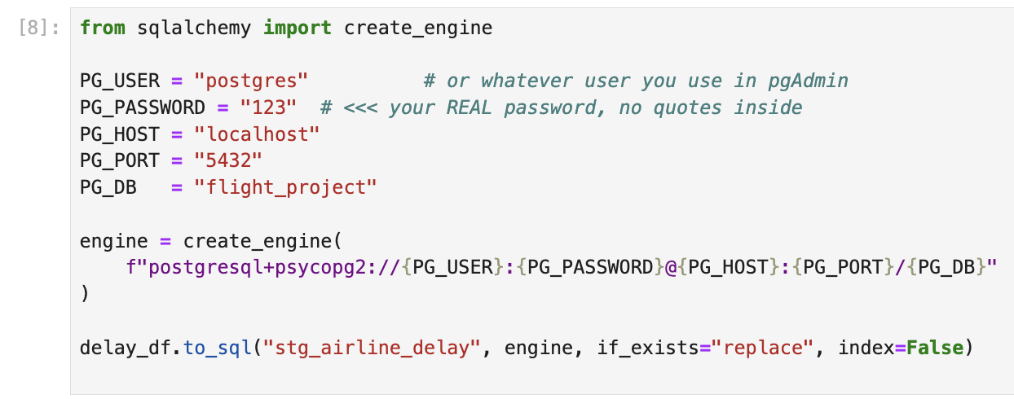
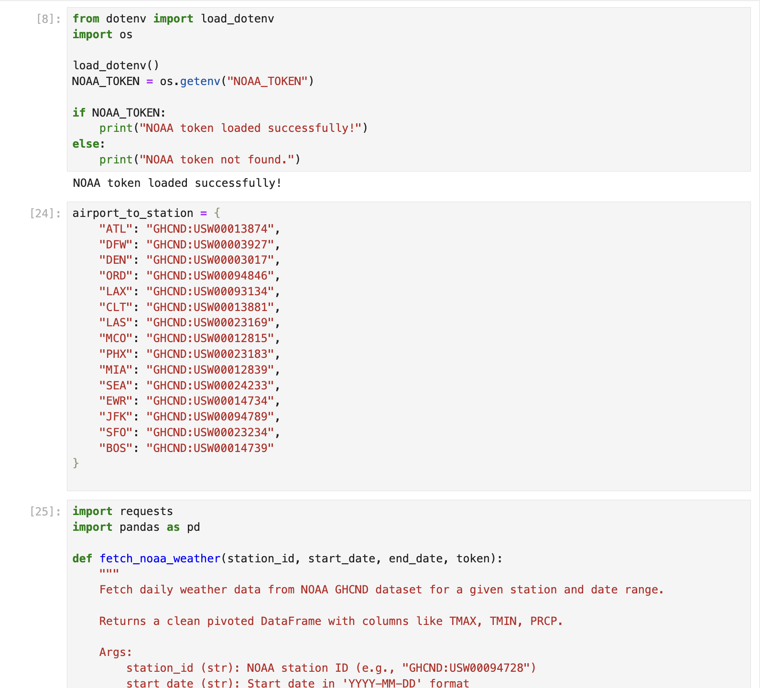
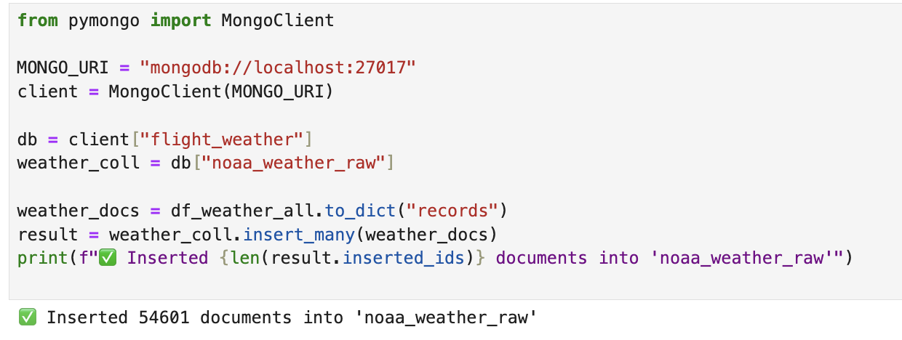
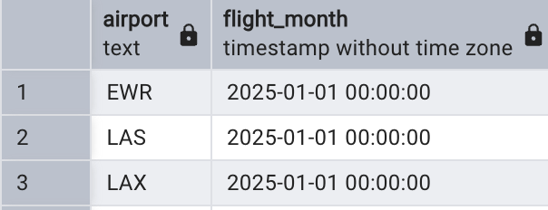
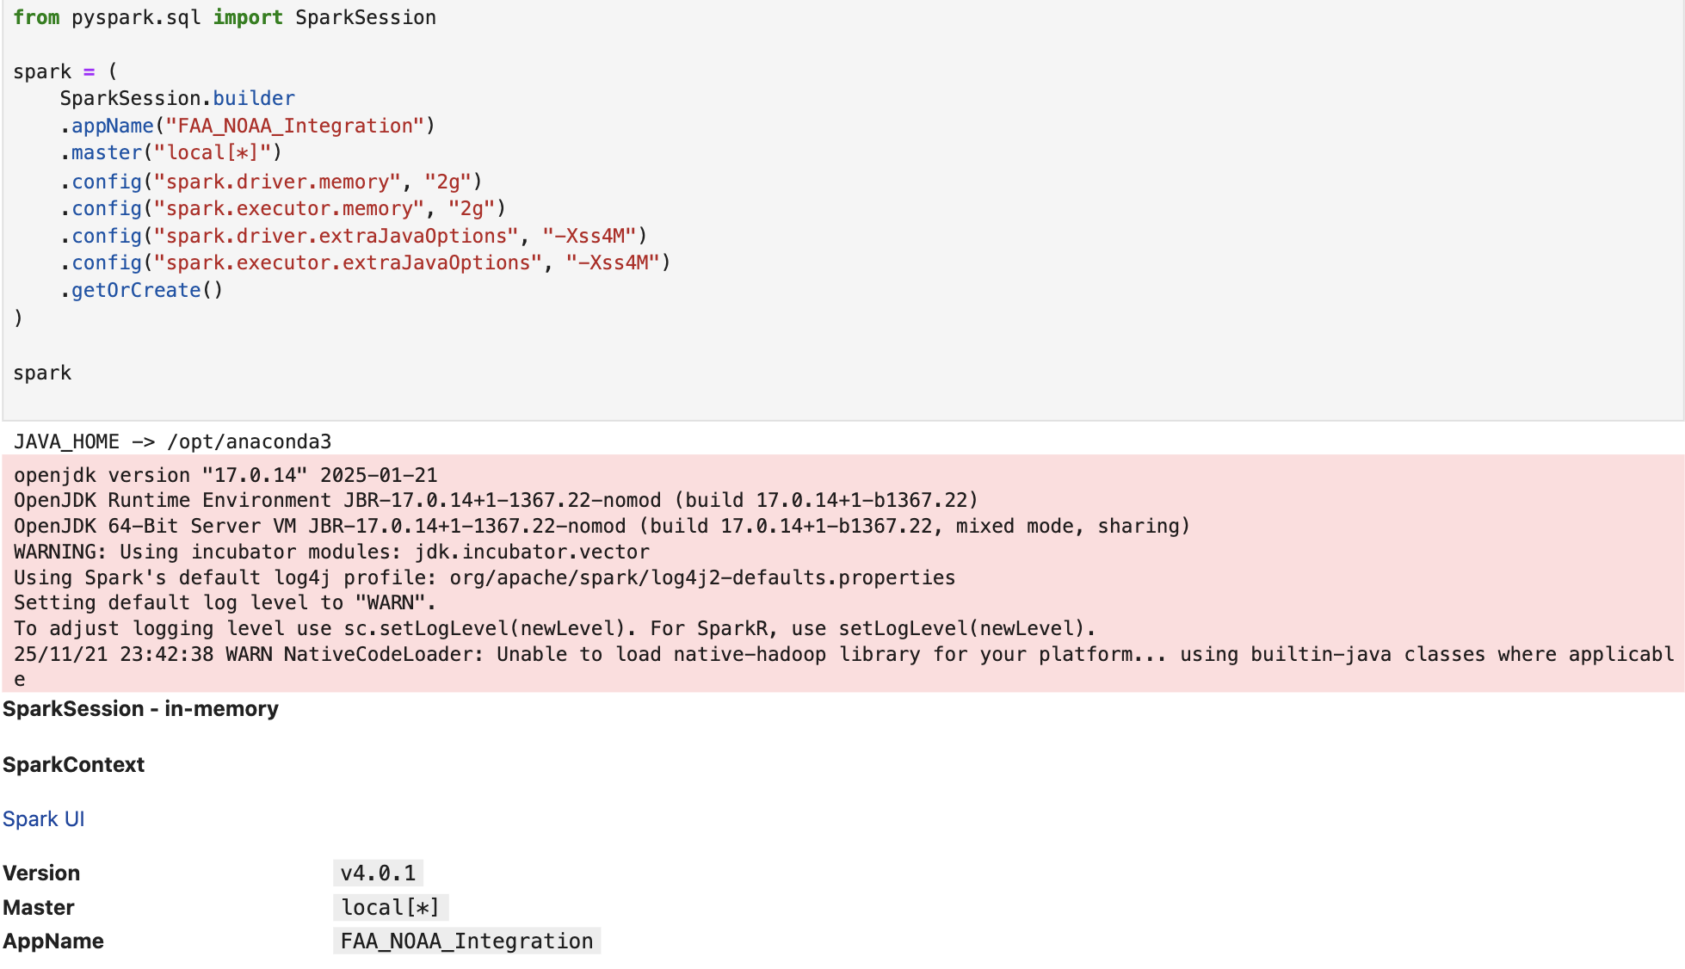
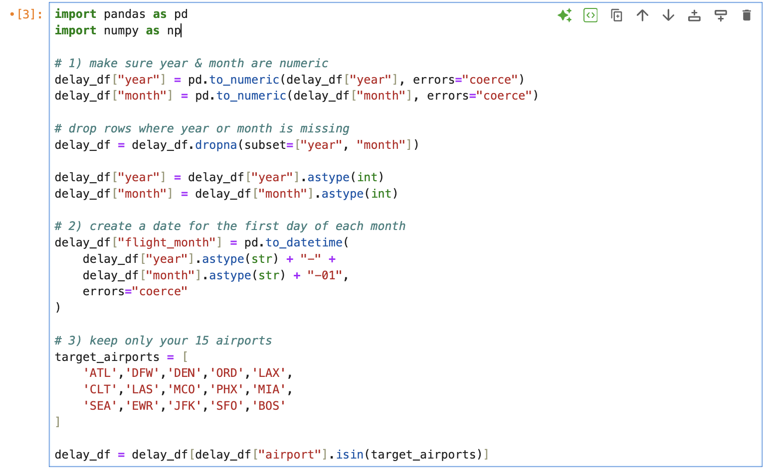
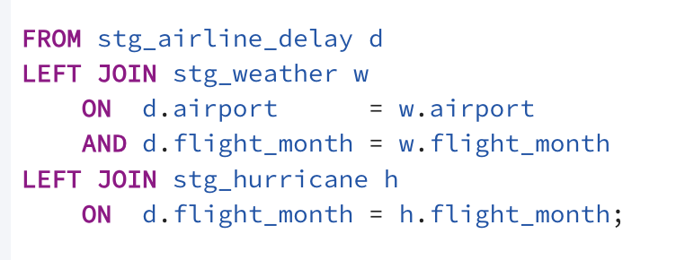
Extract Transform Load
(Code Display)
Created API connections using Spark
4. Pushed cleaned datasets to PostgreSQL
2. Connected all three datasets to MongoDB
5. Merged datasets using left join
(For both the weather and airline delay datasets, we have the airport name and the flight month where we used left join to merge the datastes together)
3. Data cleansing process in MongoDB

Slide 6
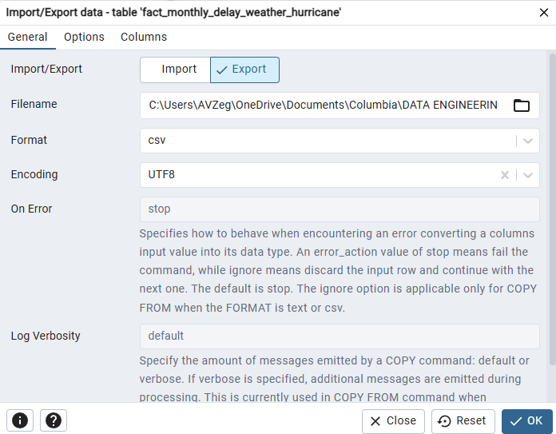
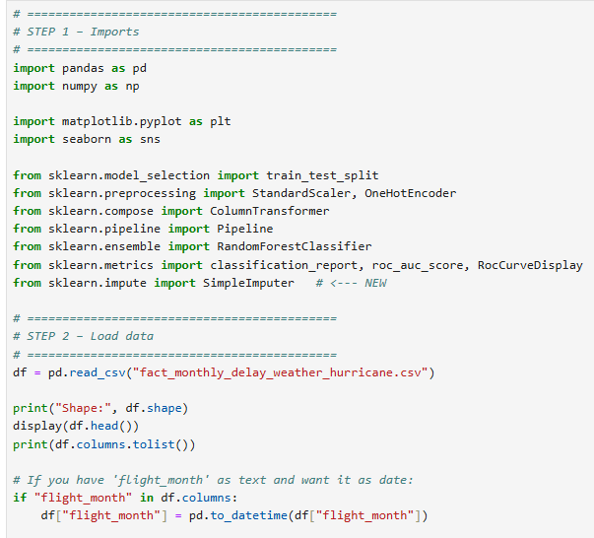
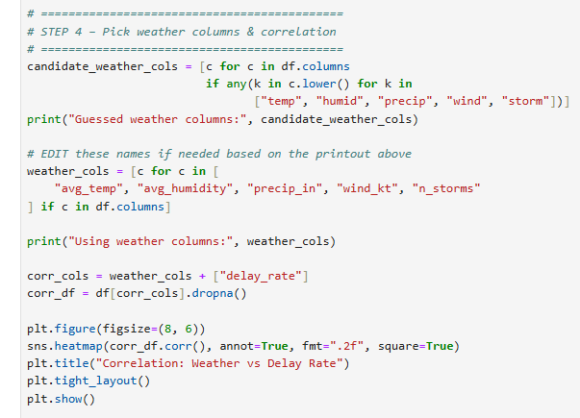
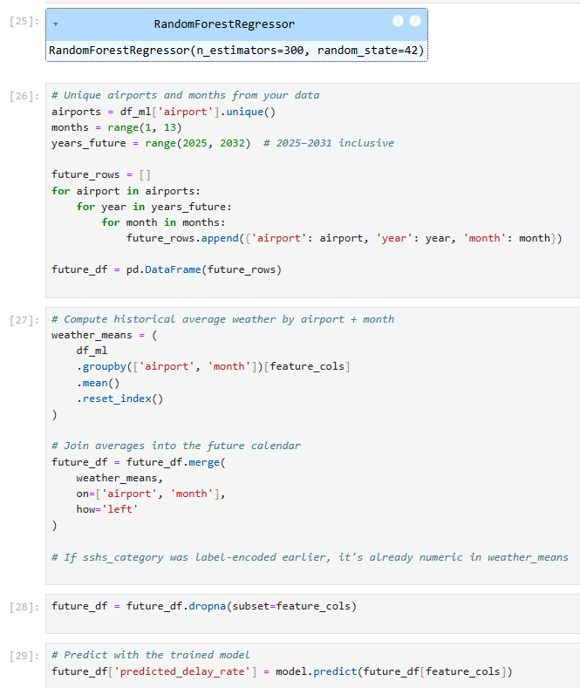
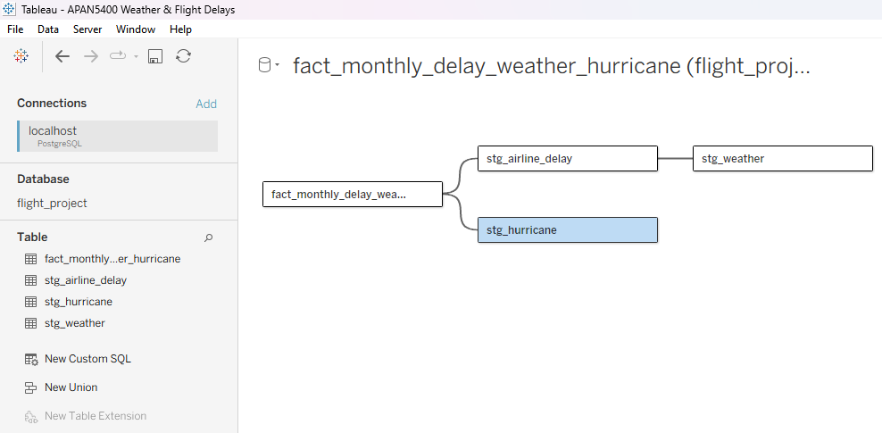
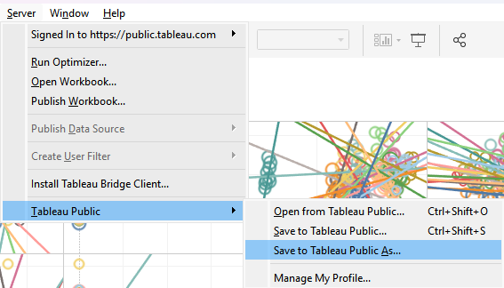
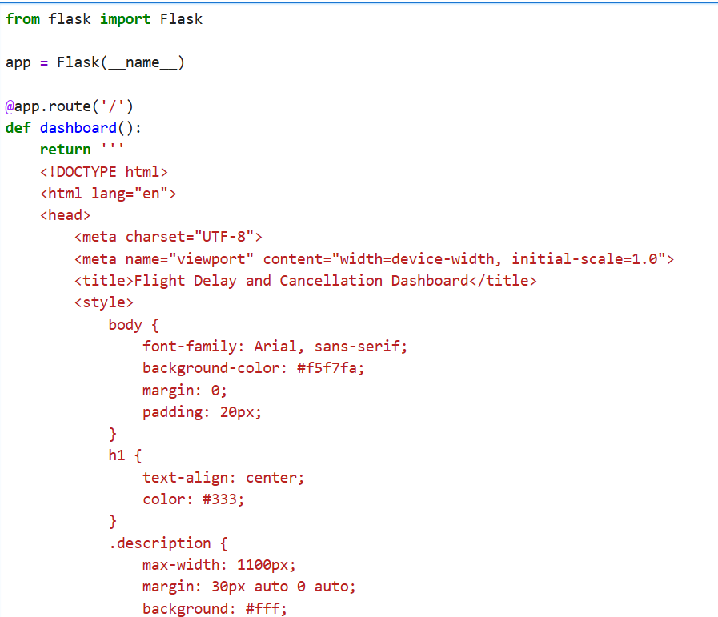
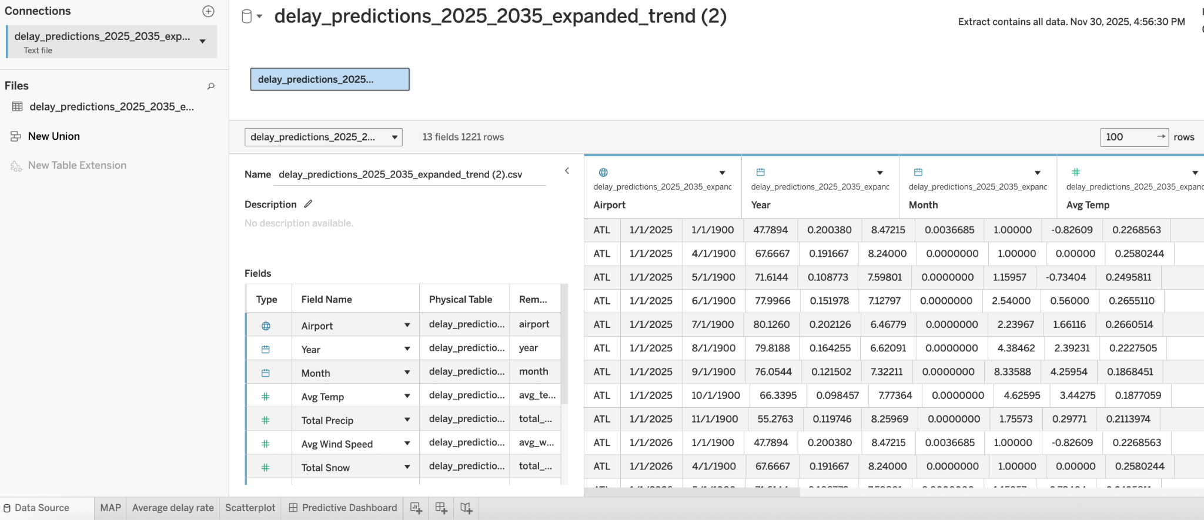
Extract Transform Load
(Code Display)
6. Exported data into CSV
7. Loaded data into Python
8. Python- Correlation between Weather & Flight delay
9. Python- Predicted Delays for 2025-2031
10. Import Dataset into Tableau (From PostgreSQL)
11. Import Dataset into Tableau (Predictive Analysis completed in Python)
12. Published Dashboards
into Tableau Public
13. Flask interface with tableau dashboard embedded

Slide 7

Nationwide Scalability Plan
Scaling from a pilot of 15 airports to all U.S. airports across 10 years. Includes: flight operations, weather, enriched delay features, and metadata.
Data Pipeline & Processing (Spark / EMR)
Run large-scale joins across airports, weather, and historical delays.
Use Spark on AWS EMR for:
feature engineering
monthly model retraining
building Tableau-ready aggregates
Medium EMR cluster (2–4 nodes) triggered monthly or weekly.
Storage & Databases
Amazon S3: Central data lake for raw, cleaned, and versioned data (~30 GB).
PostgreSQL (RDS):
Stores analytical tables
Powers Tableau dashboards
Handles structured, relational metrics
MongoDB Atlas:
Stores semi-structured weather snapshots
Airport-level metadata
JSON-based feeds used by Flask API
Visualization & Application Layer
Tableau Cloud: Airport-level dashboards, delay patterns, KPIs, and geographic comparisons.
Flask App (EC2/Fargate):
Provides prediction APIs
Serves model outputs to dashboards
Supports multi-user access

Slide 8
Cost Considerations
Data Governance & Compliance
Core Components & Costs
1. Spark (AWS EMR) ➡ $350–$500/month
Medium cluster (2–4 nodes)
Monthly processing + model updates
2. PostgreSQL (RDS) ➡ $150–$220/month
db.m5.large or similar
60–100 GB storage
3. MongoDB Atlas ➡ $70–$120/month
M20 / M30 tier (no sharding required)
4. Tableau Cloud ➡ $250–$350/month
5 Creator licenses + viewer seats + scheduled refreshes
5. Flask Hosting + Monitoring ➡ $40–$70/month
EC2 or Fargate
CloudWatch logs
6. S3 Storage (30 GB Data Lake) ➡ $10–$15/month
Total Estimated Monthly Cost ≈ $870 – $1,275 per month
Future Possibilities for Exploration
Add real-time streaming (FAA + NOAA) and multi-region dashboards → ~20–30% cost increase.
Dataset size: ~30 GB Refresh frequency: monthly or biweekly Spark processing Users: Small data team + dashboard viewers
Data | Data Type/Compliance | Security | Auditability
NOAA Historical weather data | Public and read only. Follows guidelines implemented by NOAA. | Encrypted, final datasets are open | Secure HTTPS API requests, traceable from source to publication
NOAA Hurricane data | Public and read only. Follows guidelines implemented by NOAA. | Encrypted, SOC monitoring | Secure HTTPS API requests
Airline On-Time Statistics and Delay Causes | Public, Kaggle Data | Open data, publicly downloadable | Open data with traceable ETL and loading steps

Slide 9
Team Roles
Name | Responsibilities
Ana Zegarra | Weather delay correlation modeling, Machine learning to predict delay likelihood under upcoming weather patterns, Tableau Dashboard with historical data.
Arshia Mahant | Nationwide scalability plan, cost considerations, data governance and compliance, Code and process documentation
Poorva Desai | Set initial structure for API connection. Tableau Dashboard with predictive data, utilized random forest modeling to predict future yearly delay rates by Airport.
Samatha Krishna | Created the Flask interface with description and how to interpret instructions
Shirley Zhang | Datasets API connections, Data cleansing and loading in MongoDB and PostgreSQL

Slide 10
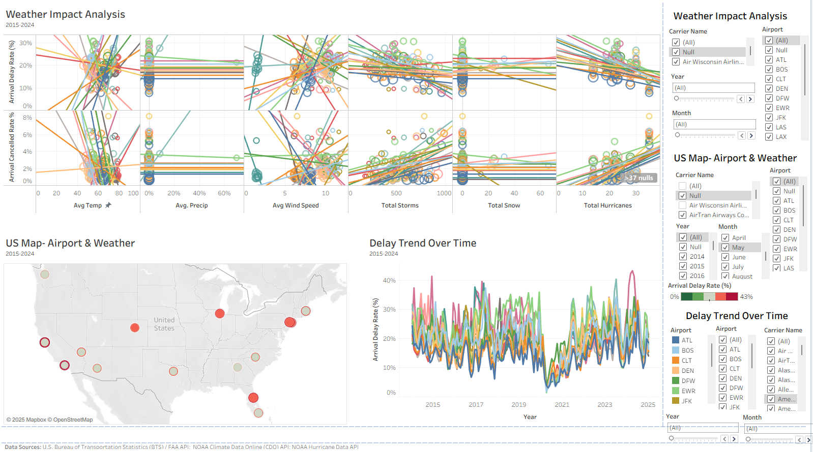
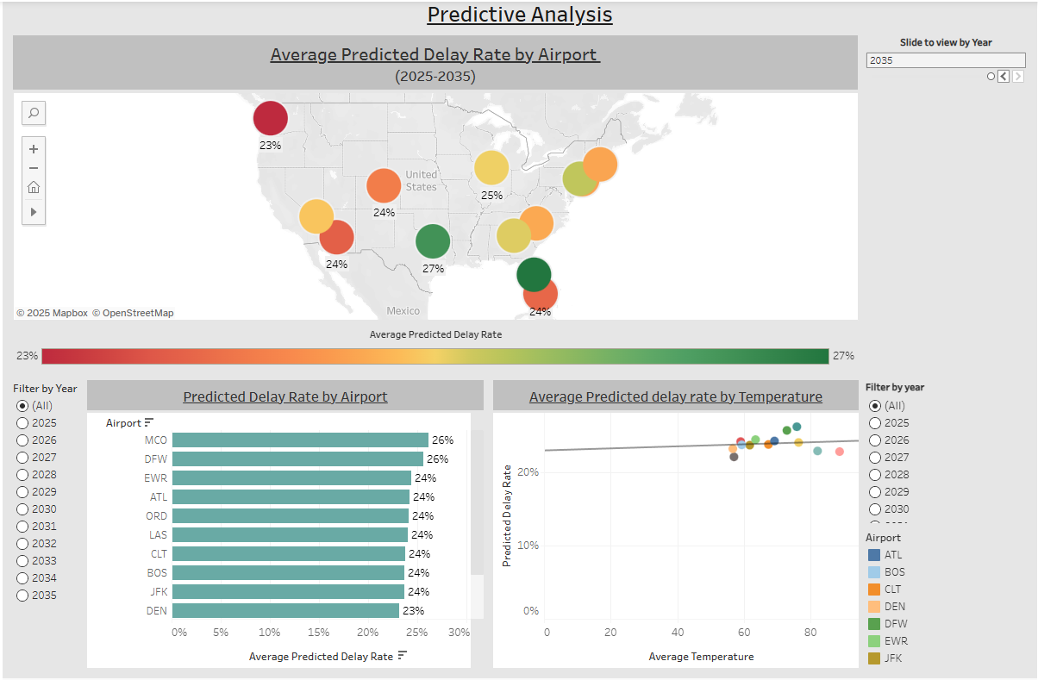
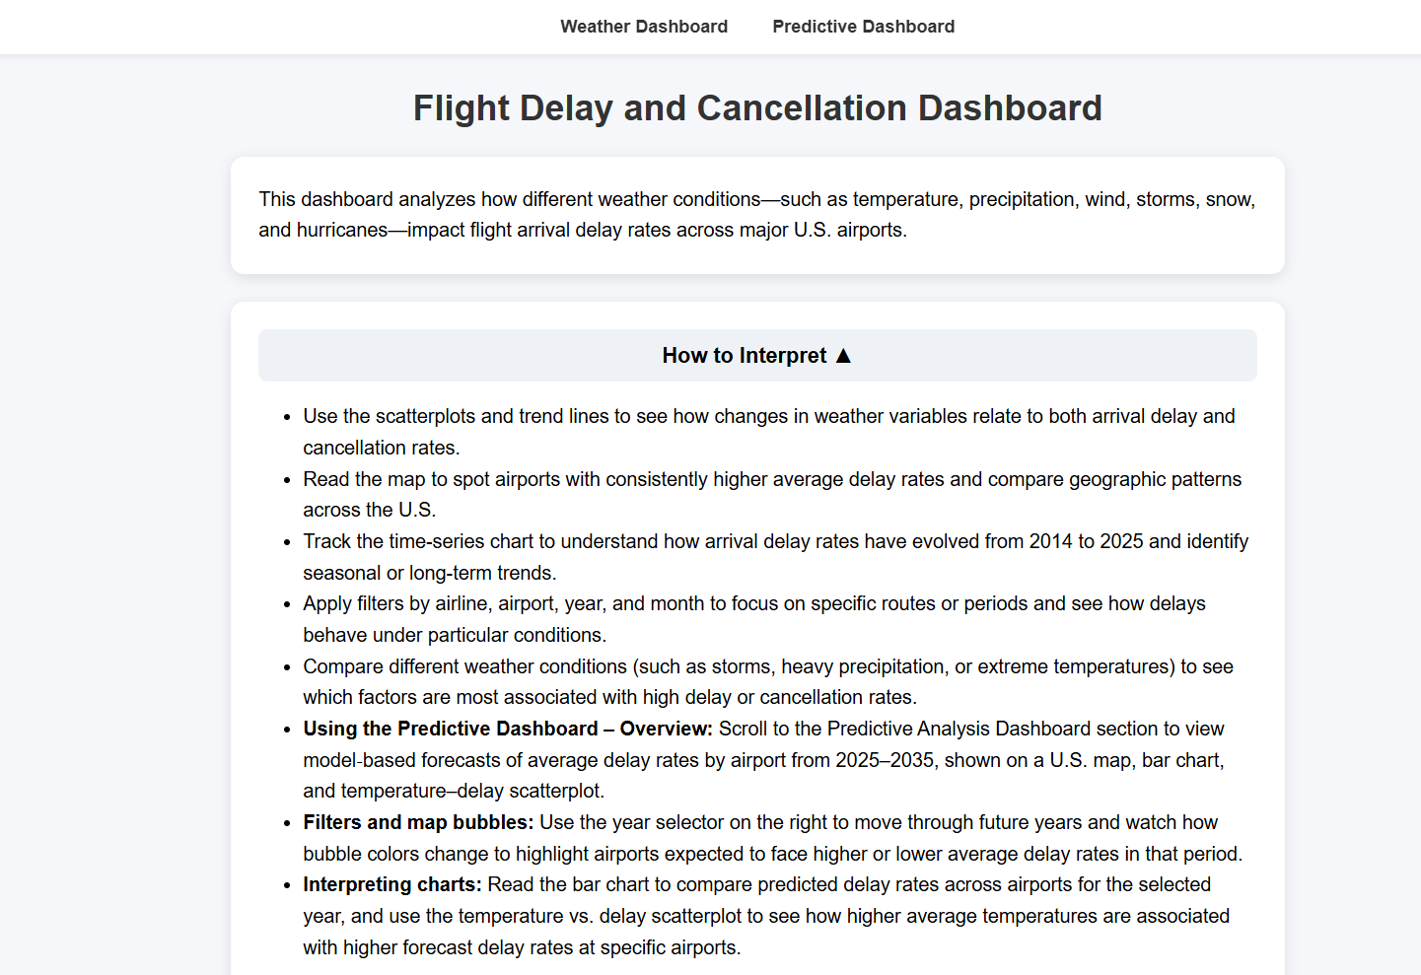
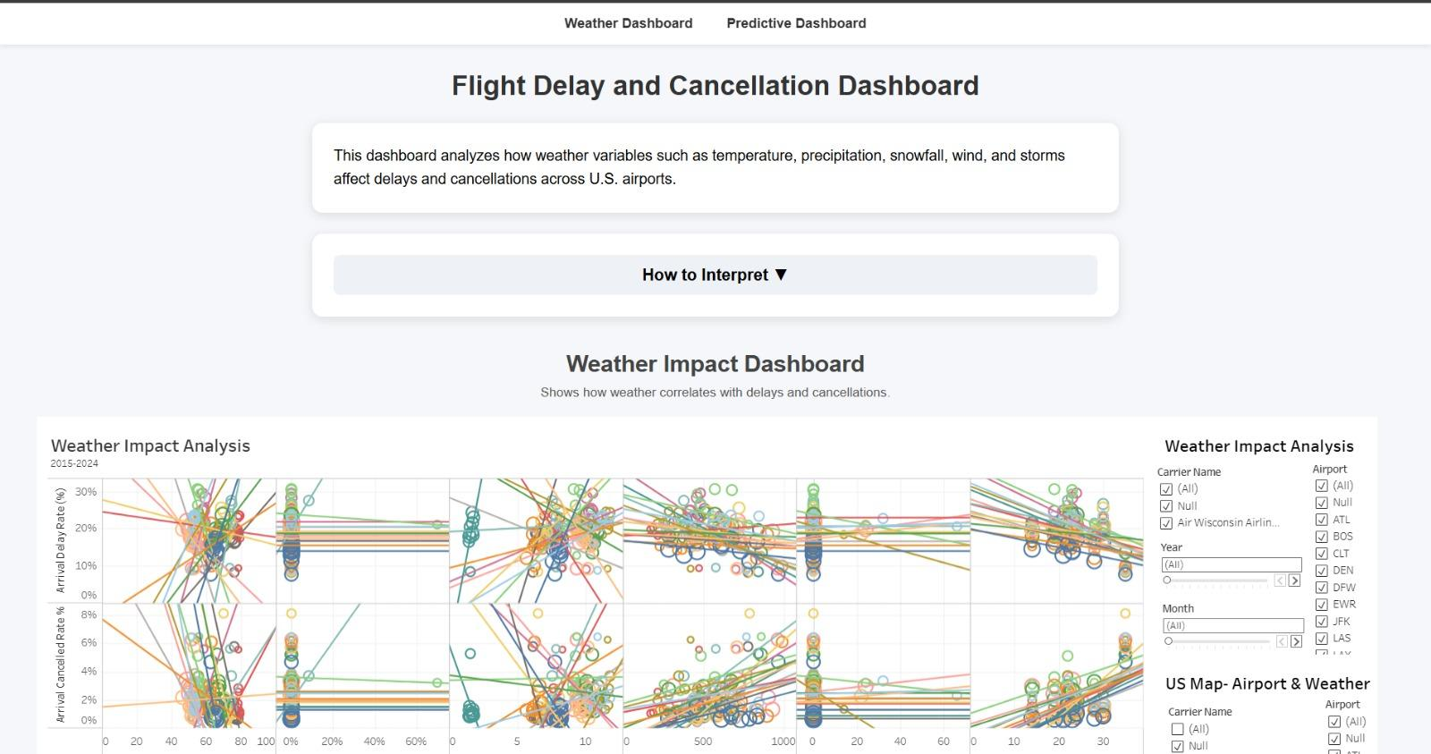
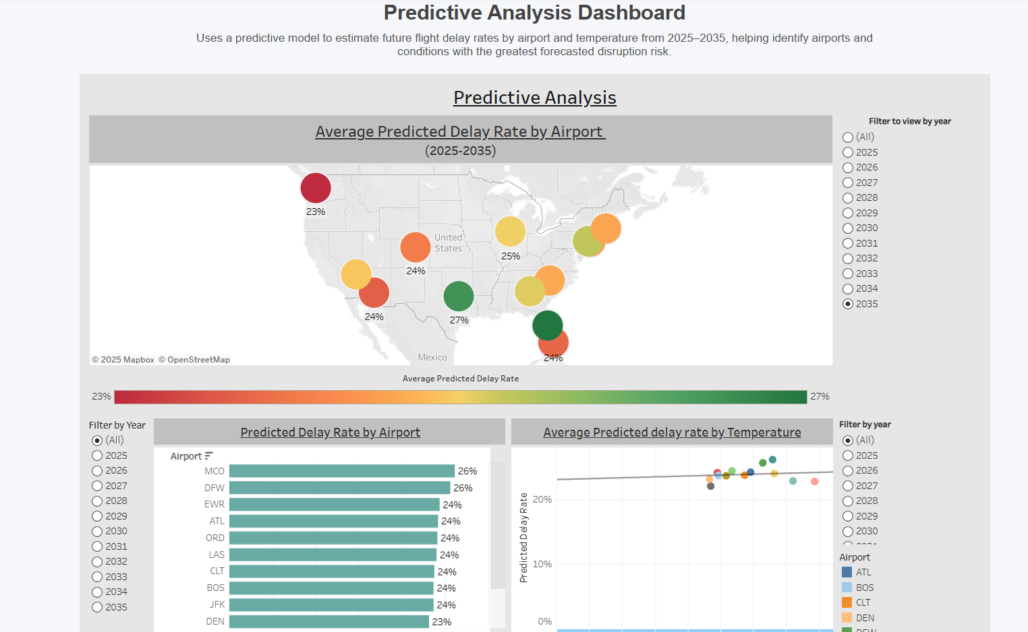
Demo: Visualization placeholder
Historical Dashboard
Predictive Dashboard
APAN5400 Weather & Flight Delays | Tableau Public
Predictive Dashboard | Tableau Public
Flask Interface

